Slide 1


Web Scraping Project on Real E-State Price Analysis Purchase & Rental
Presented by :
D Sagar
Nikhitha Kankanala
Chaitanya
Batch No: 474

Slide 2

PROBLEM STATEMENTS
The real estate market contains a large amount of property listings for both purchasing and renting, making it difficult for users to identify suitable and affordable options.
Buyers and tenants often struggle to understand price trends, property availability, and location-based differences across cities.
This project aims to analyze purchase type and rent type property datasets using exploratory data analysis (EDA) to identify patterns in property prices, popular apartment types, and affordable locations.
By analyzing the data, the project provides insights that help buyers, renters, and investors make better real estate decisions.

Slide 3

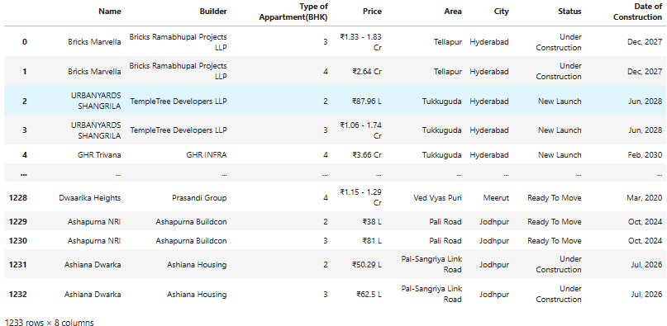
DATASET DESCRIPTION(Purchase)
DataSource: 99 acres.com
Website link: https://www.99acres.com
Dataset Size:
Buy Dataset: 1,233 records, 8 columns.
Cities Covered: Hyderabad, Noida, Bangalore, Chennai, Mumbai, Rajkot, Coimbatore, and more.
Tools: Python, Requests, BeautifulSoup, Pandas, NumPy, Matplotlib, Seaborn
Raw Data Purchase

Slide 4
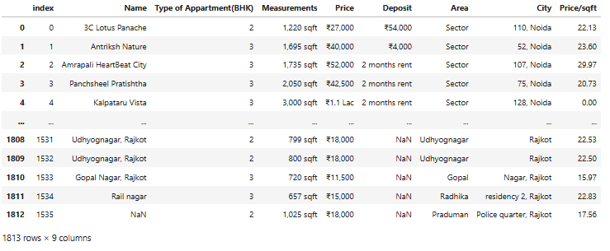
DATASET DESCRIPTION(Rental)
DataSource: 99 acres.com
Website link: https://www.99acres.com
Dataset Size: -
Rent Dataset: 1,813 records, 9 columns.
Cities Covered: Hyderabad, Noida, Bangalore, Chennai, Mumbai, Rajkot, Coimbatore, and more.
Tools: Python, Requests, BeautifulSoup, Pandas, NumPy, Matplotlib, Seaborn
Raw Dataset Rental

Slide 5
RAW DATASET
The raw datasets initially contained textual and numeric information about real estate properties. Each row represents a unique property listing, while each column represents a specific attribute related to that property.
Before analysis, the data contained inconsistent formats, missing values, and textual characters in numeric columns, which required cleaning and transformation.
The raw dataset provides the foundation for further data preprocessing and exploratory analysis.

Slide 6
DATA CLEANING & COLUMN TRANSFORMATION
Several transformations were applied to prepare the data for analysis.
Cleaning Price Column
Removed ₹ symbol and commas
Converted Crore and Lakh values into numerical format
Builder Column Cleaning
Incorrect entries replaced with NA
Date of Construction
Extracted Month and Year
Converted to datetime format
Measurements
Removed text like sqft
Converted values into numeric format

Slide 7
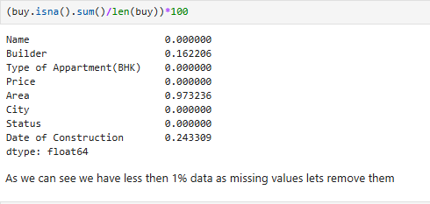
Missing Value Analysis
TREATING NULL VALUES(Purchase)
Percentage of Null values in each column:-
Purchase Dataset: -
Less than 1% missing values
Missing rows were removed using dropna()

Slide 8
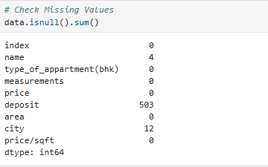
Missing Value Analysis
TREATING NULL VALUES(Rental)
Count Null values in Each Column:-
Rent Dataset:-
Missing values handled using:
Deposit column filled with 0
Missing rows were removed using dropna()

Slide 9
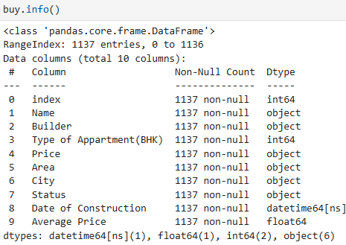
Missing Value Analysis
DATASET AFTER CLEANING(Purchase)
Information OF DataFrame:-
Purchase Dataset: -
As we can see purchase dataset is cleaned and has no NULL values.
After cleaning we got 1137 rows

Slide 10
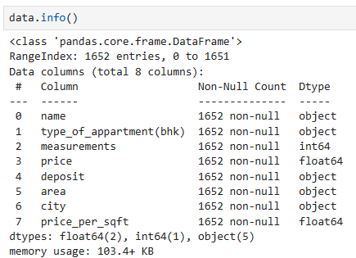
Missing Value Analysis
DATASET AFTER CLEANING(Rental)
Information Of Rent data After Cleaning:-
Rental Dataset: -
As we can see rental dataset is cleaned and has no NULL values.
After cleaning we got 1652 rows

Slide 11
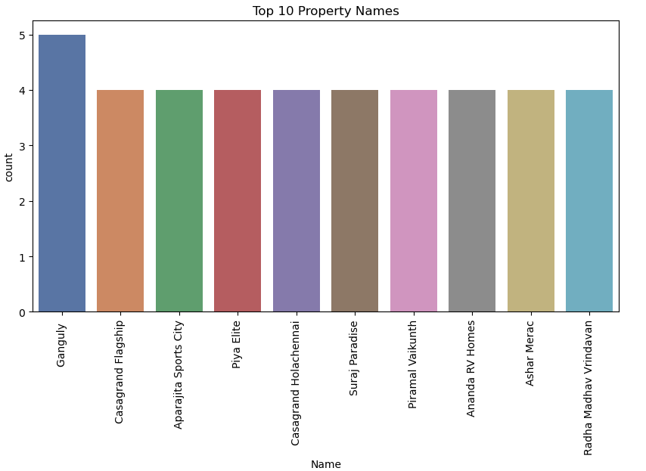
Univariate Analysis
UNIVARIATE ANALYSIS
Bar Plot showing top 10 properties to purchase across all cities:-
This visualization shows the distribution of property listings based on their property or project names. Each bar represents a property project, while the height of the bar indicates the number of listings associated with that property.
The analysis helps identify which residential projects appear more frequently in the dataset and therefore may have higher availability or popularity in the real estate market.

Slide 12
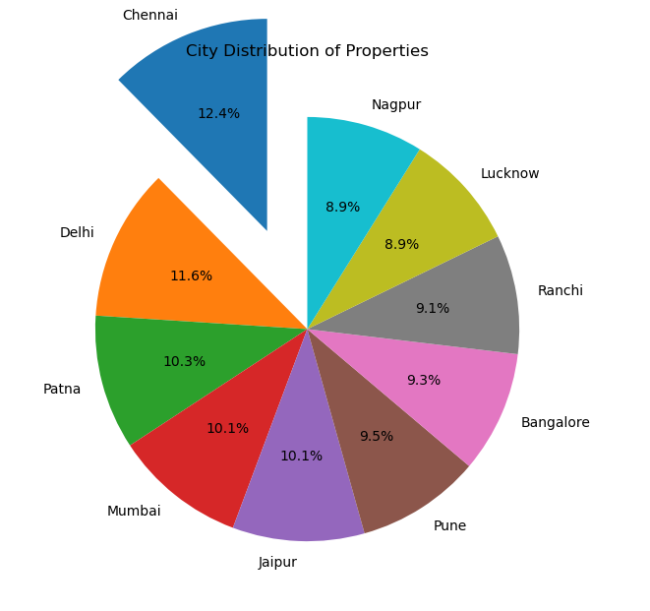
UNIVARIATE ANALYSIS
City Distribution of Properties
Pie chart showing property distributions in each city:-
This visualization shows the distribution of real estate listings across different cities in the dataset. Each bar represents a city, while the height of the bar indicates the number of property listings available in that city.
The analysis helps identify which cities have a higher concentration of real estate properties and where most housing listings are located.

Slide 13
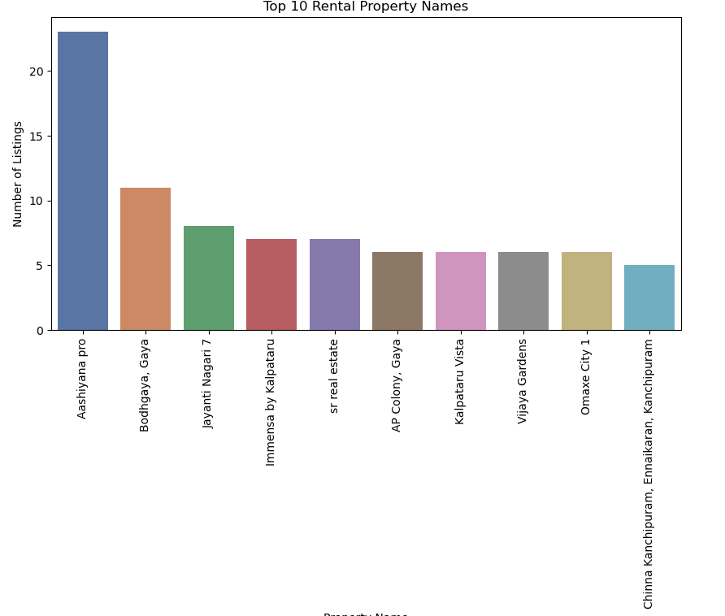
UNIVARIATE ANALYSIS
Top 10 Rental Property Names:-
Ashiyana Pro has the highest number of rental listings, significantly higher than all other properties, indicating strong rental activity or higher availability in that project.
Bodhgaya Gaya and Jayanthi Nagar 7 also show relatively high listing counts, suggesting these residential projects are popular rental locations.

Slide 14
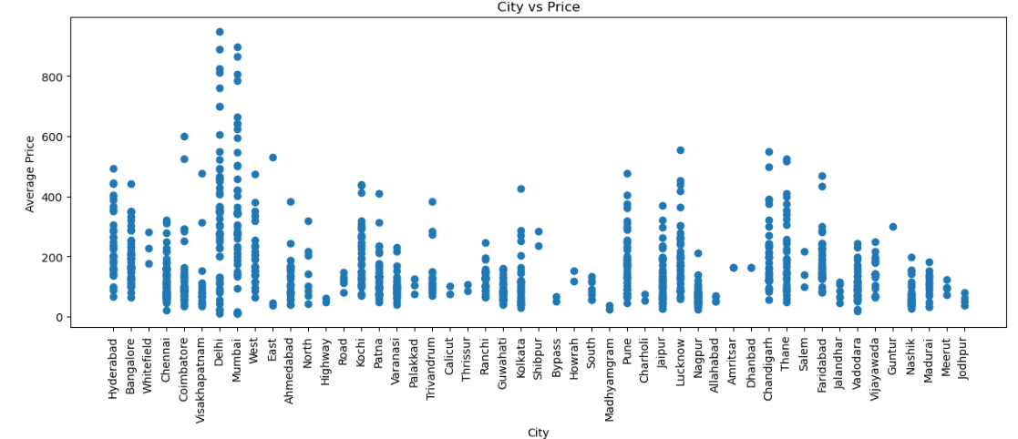
Bi-Variate Analysis
BIVARIATE ANALYSIS
Scatter Plot Prices in Each city:-
The scatter plot shows that property prices vary widely across different cities, with some cities like Mumbai and Delhi showing higher price ranges compared to others.
Most cities have prices concentrated in the lower to mid range (around 50–300), while only a few cities contain very high-priced properties above 500.

Slide 15
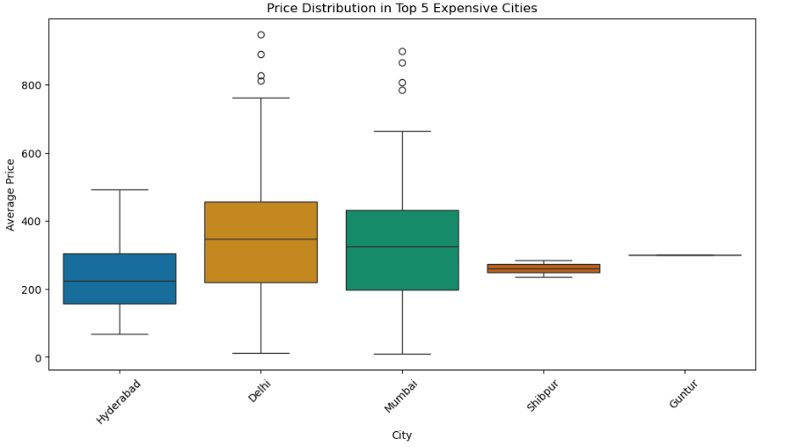
BIVARIATE ANALYSIS
Average Prices In Top 5 Cities:-
The analysis identifies Thane and Coimbatore as high-value leaders, while cities like Meerut provide the most consistent entry-level pricing.
The wide variance in the box plots for major metros suggests a diverse inventory that caters to
both middle-income buyers and luxury investors.

Slide 16
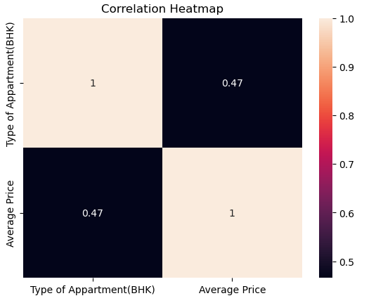
BIVARIATE ANALYSIS
Correlation between BHK and average price:-
The heatmap reveals a strong positive correlation between apartment size (BHK) and price, confirming that space remains the primary value driver.
This multivariate view highlights that while configuration dictates the base cost, geographic location and
project maturity create the final price variance.

Slide 17
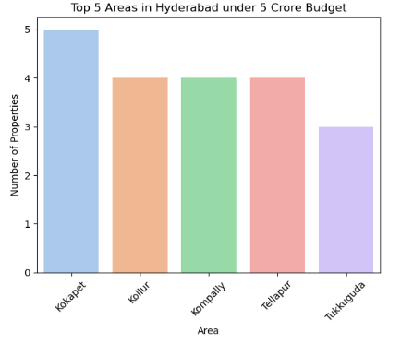
BIVARIATE ANALYSIS
Multi Variate Analysis
Bar Plot Showing Areas in Hyderabad under 5cr:-
Kokapet has the highest number of properties (5) under the 5-crore budget, making it the most prominent area for property availability.
Kollur, Kompally, and Tellapur show similar availability with around 4 properties each, indicating balanced housing options.

Slide 18
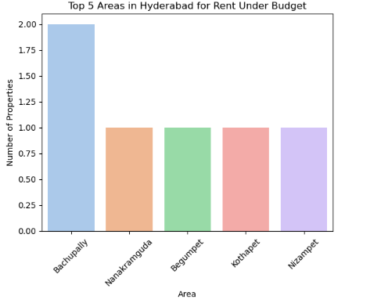
BIVARIATE ANALYSIS
Multi Variate Analysis
Bar Plot Showing Areas in Hyderabad under 40kfor rent:-
This plot identifies areas in Hyderabad that offer the most rental properties within a given budget(40k).
These areas may be suitable for tenants seeking cost-effective housing options.

Slide 19
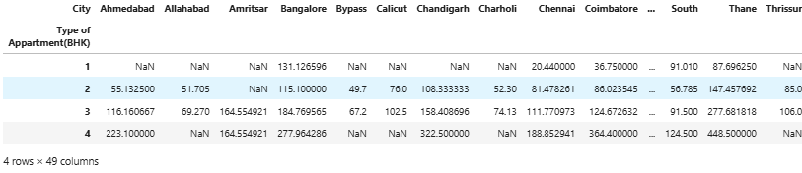
Pivot Tables
PIVOT TABLE
The table shows the average property price for different apartment types (1–4 BHK) across multiple cities.
Prices generally increase as the BHK size increases, meaning larger apartments (3–4 BHK) are significantly more expensive than 1–2 BHK.

Slide 20
Key Insights
KEY INSIGHTS
Property Distribution Across Cities Some cities have a higher number of property listings for both buying and renting, indicating stronger real estate activity and housing demand in those locations.
Popular Apartment Configurations Mid-sized apartments such as 2BHK and 3BHK dominate both buy and rental markets, showing higher demand for these property types.
Affordable Cities and Locations Certain cities and areas offer more properties within a given budget, helping buyers and tenants identify cost-effective housing options.
Location Impact on Real Estate Prices Property prices and rental rates vary significantly depending on city, locality, and project development, showing the importance of location in real estate decisions.

Slide 21
Conclusion
CONCLUSION
This project analyzed real estate listings for both purchasing and renting using data collected from 99acres.
After cleaning and preprocessing the datasets, various univariate, bivariate, and multivariate analyses were performed to understand property distribution, price trends, and location patterns.
The analysis shows that property size, city location, and apartment configuration significantly influence both purchase prices and rental costs.
These insights help users identify affordable cities, popular housing configurations, and suitable locations for buying or renting properties.

Slide 22


